Slide 1
Module 3.2 / Week 6
Understanding and assessing internal control

Slide 2
Learning Objectives
  6.1 Explain the concept of internal control, its inherent limitations and how it links to the audit strategy.
  6.2 Describe the general objectives of internal control and how the auditor uses them to develop specific control objectives.
  6.3 Identify and define each of the components of internal control.
  6.4 Identify the steps in a financial report audit by which the auditor obtains an understanding of internal control and assesses control risk, and the methods and procedures used by the auditor in each step.
  6.5 Distinguish between user controls and information technology (IT) controls, between general controls and application controls, and between automated controls and manual controls, and identify the general controls and application controls that affect the auditor’s assessment of control risk in a computerised system.

Slide 3
LO 6.1
Internal control and
audit strategy

Slide 4
Internal controls
Internal control is ‘the process designed and implemented by those charged with governance, management and other personnel to provide reasonable assurance regarding:
the achievement of the entity’s objectives concerning financial reporting
the effectiveness and efficiency of operations, and
compliance with laws and regulations’ (ASA 315.4 / ISA 315.4).

Slide 5
Responsibility for internal control
  Achieving satisfactory internal control is initially a management responsibility, although ultimate responsibility rests with those charged with governance.
  Effective internal control is central to efficient risk management.
  To maintain control over operations and accounting data, management needs to adopt, maintain and supervise an appropriate internal control system.

Slide 6
Auditor’s requirements
  ASA/ISA 315.12 requires auditor to obtain an understanding of internal control relevant to the audit.
  Financial report level: auditor’s assessment of risk of material misstatement is affected by their understanding of the control environment (ISA/ISA 315.A123).
  Assertion level: Auditor needs to consider control risk in their assessment of risk of material misstatement (ASA/ISA 315.26).

Slide 7
Inherent limitations of internal control
  Internal control cannot assure a reliable financial report because it has inherent limitations.
  Inherent limitations arise because of:
              control breakdowns as a result of the actions of careless or fatigued staff, or intentional collusion
              the possibility of management override
              the existence of non-routine transactions for which internal controls were not devised.
  The concept of reasonable assurance recognises that, in some cases, the cost of management establishing and maintaining controls can outweigh the benefits of adopting controls.

Slide 8
Audit strategy
  In order to issue an opinion on the financial report, the auditor must consider audit risk for each assertion for each significant account balance, class of transactions and events, and disclosure, and reduce it to an acceptable level.
  ASA/ISA 200.13 and ASA/ISA 200.A39 indicate that the risk of material misstatement at the assertion level consists of two components: inherent risk and control risk.

Slide 9
Control risk
  Control risk is the risk that a material misstatement could occur in an assertion and not be prevented or detected on a timely basis by the entity’s internal control.
  Auditor assesses control risk as high or less than high. If control risk is assessed as less than high, tests of control need to be performed to gain evidence that specific control activities have been effectively and consistently applied throughout the period under audit.

Slide 10
LO 6.2
Internal Control objectives

Slide 11
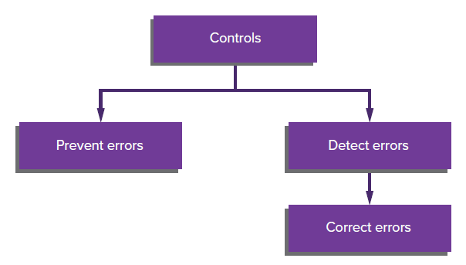
Types of internal controls
Preventative controls—internal controls that are used to prevent undesirable events or errors.
Detective controls—internal controls that are used to identify events or errors if they have occurred.
Source: Grant, G. & Simnett, R. (2018). Auditing & Assurance Services In Australia (7th Ed), Sydney, Australia: McGraw Hill

Slide 12
Management controls
Definition: ‘The activities undertaken by senior management to mitigate strategic risks to the entity and promote effectiveness of decision making and efficiency of business activities’.
These include:
                communicating business objectives and goals
                establishing lines of authority and accountability
                establishing and enforcing appropriate codes of conduct
                monitoring risk environments
                defining policies and procedures for dealing with
                these risks
                monitoring performance through performance
                indicators and benchmarking.

Slide 13
Transaction controls
Performed by staff and lower level management. Every transaction goes through the identifiable steps of authorisation, execution and recording.
These controls:
    are generally focused on internal risks and reflect
    the formal policies and procedures defined by senior management
    deal primarily with the reliability of accounting information and compliance with rules and regulations
    control the flow of transactions through the accounting system and safeguard related assets by authorising
    and recording transactions, restricting access to
    assets and checking for existence of recorded assets

Slide 14
Characteristics of satisfactory internal control
  Controls to monitor and minimise business risks.
  Segregation of incompatible duties and responsibilities.
  System of authorisation, recording and other procedures adequate to provide control over assets, liabilities, revenues and expenses.
  Sound business practices such as pre-numbering of transactions and sequence checks.
  All personnel should have capabilities commensurate with responsibilities.

Slide 15
LO 6.3
Components of internal
control (IC)

Slide 16
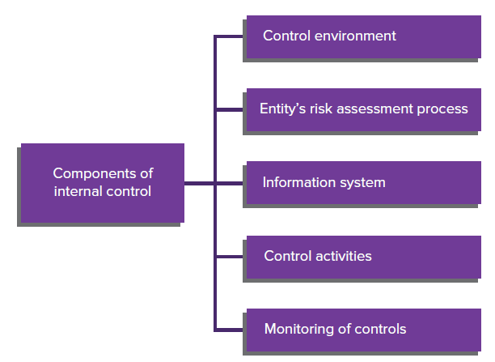
Components of internal control (IC)
Source: Grant, G. & Simnett, R. (2018). Auditing & Assurance Services In Australia (7th Ed), Sydney, Australia: McGraw Hill

Slide 17
Control environment
  Includes governance and management’s overall attitude, awareness and actions regarding IC and its importance in the entity (ASA/ISA 315.A77).
  Auditors should consider:
            communication and enforcement of integrity and ethical values
            commitment to competence
            participation by those charged with governance
            management’s philosophy and operating style
            organisational structure
            assignment of authority and responsibility
            human resource policies and practices.

Slide 18
Entity’s risk assessment process
  Entity’s way of identifying and responding to business risks.
  Once risks are identified, management needs to consider their significance and how they should be managed.
  Management may introduce plans to address specific risks or it may accept a risk on a cost-benefit basis.

Slide 19
Information system
  An effective information system establishes the records and the methods that
              identify and record all valid transactions
              resolve incorrect processing of transactions
              process and account for system overrides
              transfer information from transaction processing systems to the general ledger
              capture information relevant to financial reporting for events and conditions other than transactions
              present the transactions and related disclosures properly in the financial report.

Slide 20
Control activities
  Policies and procedures established by management to ensure its directives are carried out.
  Can pertain to:
            performance reviews (e.g. comparing actual with budget)
            information processing, in an information technology (IT) environment comprising general IT controls and application controls (discussed later this chapter)
            physical controls (e.g. locked storerooms for inventory)
            segregation of duties (the most basic of which is to have different individuals responsible for handling assets and the keeping of records relating to those assets).

Slide 21
Segregation of duties related to a transaction
  A transaction may be considered to pass through four phases:
  Authorisation — the initial authorisation or approval for an exchange transaction.
  Execution — the act that commits the entity to the exchange, such as placing an order.
  Custody — the physical act of accepting, delivering or maintaining the asset.
  Recording — the entry of the transaction data into the accounting system.
Ideally, all four phases should be kept separate.

Slide 22
Control activities and assertions
  Control activities can be related to financial report assertions:
          occurrence (e.g. authorisation and approval of transactions)
          completeness (e.g. accounting for sequence of transactions)
          accuracy (e.g. checking dollar amounts back to supporting documentation)
          cut-off (e.g. independent review of transaction recording around balance date)
          classification (e.g. independent checking of account coding).
          presentation (e.g. appropriately aggregating and disaggregating and clearly describing items).

Slide 23
Monitoring of controls
  Monitoring of controls:
    A process used to assess the effectiveness of the performance of internal control.
    It involves:
          evaluating the design and operation of controls
          taking corrective action where necessary.
  Management may monitor controls through ongoing activities such as supervisory activities or separate evaluations.
  In many entities internal auditors contribute
  to the monitoring process.

Slide 24
Understanding internal control
  The auditor obtains an understanding of internal controls to assess control risk and:
            identify the types of potential misstatements that could occur and the factors that contribute to the risk that they will occur
            understand the accounting system sufficiently to identify the client documents, etc., that may be available and ascertain what data will be used in audit tests
            determine an efficient and effective approach to the audit.
  Where the auditor assesses control risk as less than high, they must consider operating effectiveness and gather evidence to support this assessment. This evidence will be obtained through tests of control

Slide 25
Understanding the control environment
  An auditor gains an understanding of the control environment by:
              making enquiries of key management personnel
              inspecting documented policies and procedures
              observing activities and operations.

Slide 26
Understanding the risk assessment process
  Auditor needs to determine how management identifies business risks, estimates their significance, assesses their likelihood of occurrence and decides upon actions to manage them.
  Auditor enquires of management about business risks that management have identified and considers whether they may result in a material misstatement.
  If auditor identifies a risk of material misstatements that management failed to identify, they need to consider whether management should have identified it and, if so, why the process failed.

Slide 27
Understanding the information system
  Auditor is required to obtain sufficient knowledge of the information system to understand:
                significant classes of transactions
                initiation of transactions
                records, documents and accounts
                accounting processing
                financial reporting processes
                controls surrounding journal entries.
  Being able to follow transaction flows (the audit trail) is an important technique in understanding the information system.

Slide 28
Understanding the control activities
  Procedures include:
          making enquiries of appropriate client personnel
          inspection of documentation
          observation of the entity’s activities, operations
          and procedures
          walk-through—auditor traces one or a few transactions of each type through the related documents and accounting records, observing related processing and control procedures in operation.

Slide 29
Understanding monitoring of controls
  Auditor is required to obtain an understanding of how the entity monitors internal control over financial reporting and initiates corrective actions.
  In many entities, internal auditors contribute to the monitoring of an entity’s activities.
  The auditor needs to obtain an understanding of the sources of the information related to the entity’s monitoring activities and the basis upon which management considers the information to be sufficiently reliable.

Slide 30
Documenting the understanding of internal control
Internal control questionnaires and checklists
Narrative memoranda - written description of internal control policies and procedures
Flowcharts

Slide 31
Assessing control risk
  After obtaining an understanding of the five components of internal control, the auditor assesses control risk for the assertions embodied in the account balance, transaction class and disclosure component of financial report.
  The auditor must decide whether to assess control risk for a particular assertion as high or as less than high.

Slide 32
Assessment of control risk as high
  The auditor may assess control risk as high because the entity’s internal control policies and procedures in the area:
              are poor and do not support less than a high assessment
              may be effective, but the audit tests would be more time consuming than performing direct substantive tests
              do not pertain to the particular assertion.

Slide 33
Assessing control risk as less than high
  The auditor may decide to assess control risk as less than high when it improves audit efficiency.
  If the auditor assesses control risk as less than high, the auditor must obtain sufficient evidence to support that level.
        First, the auditor identifies specific control activities that are likely to prevent or detect material misstatements.
        Next, the auditor performs tests of controls to evaluate the effectiveness of these control activities.
  This process is followed for each account balance or transaction class material to the financial report.

Slide 34
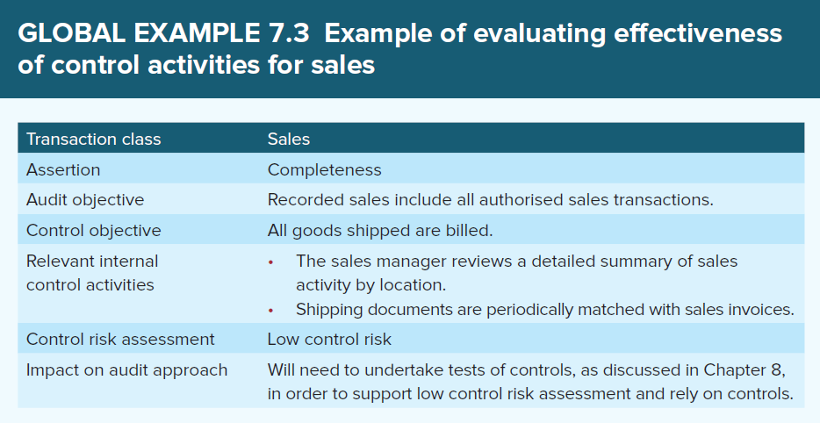
Evaluating effectiveness of control activities for sales
Source: Grant, G. & Simnett, R. (2018). Auditing & Assurance Services In Australia (7th Ed), Sydney, Australia: McGraw Hill

Slide 35
Tests of controls
  If control risk is assessed as less than high, evidence is needed to support the conclusion that specific policies and procedures that are likely to prevent or detect misstatements are effective.
  The evidence should demonstrate both:
    the effectiveness of the design of the policies and procedures
    the operating effectiveness of the policies and procedures, that is, their consistent and proper application.
  The evidence necessary to support a specific level of control risk is a matter of audit judgment.

Slide 36
Effect on design of substantive tests
  Auditor’s assessment of control risk is used in planning substantive tests for the various assertions within the transaction classes or account balances.
  The higher the level of assessed control risk, the lower the level of reliance placed on the internal control and the more assurance the auditor must obtain from substantive tests.

Slide 37
LO 6.5
Computerised Systems

Slide 38
Computerised system
      ASA/ISA 315.18 requires the auditor to have an understanding of the information system, including the related business processes.
      Many auditors now use what is known as the COBIT (control objectives for information and related technology) framework to identify how the business processes and the IT processes interrelate with each other.
      While COBIT is an IT governance framework, it is also useful for auditors in obtaining an understanding of IT.

Slide 39
Levels of control in computerised systems
There are two main categories:
User controls—those controls established and maintained by departments whose processing is performed by computer.
IT controls—those controls established and maintained at the location of the computer, for example in data-processing departments.

Slide 40
General controls and application controls
      IT controls can be further divided into general and application controls.
          general controls relate to a number of application systems
          application controls relate to a specific accounting application.
      User controls are always application controls.

Slide 41
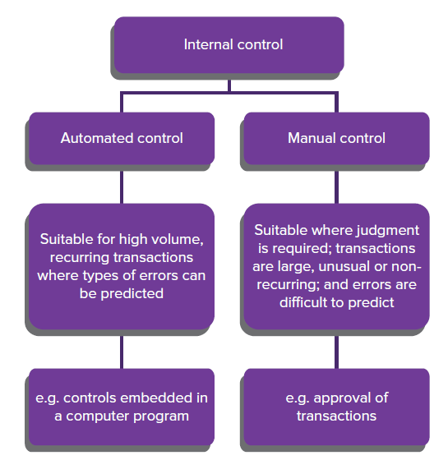
Automated and manual controls
Source: Grant, G. & Simnett, R. (2018). Auditing & Assurance Services In Australia (7th Ed), Sydney, Australia: McGraw Hill

Slide 42
Procedures for identifying related parties
      Review the previous period’s working papers for known related parties.
      Make enquiries of management concerning the names of all related parties.
      Review the entity’s procedures for identifying related parties.
      Enquire about management’s and directors’ affiliations with other entities.
      Review minutes of meetings.
      Enquire of other auditors involved in audit.

Slide 43
General controls
      General controls are manual and automated controls that relate to all or many computerised accounting applications.
      They maintain the integrity of the information and the security of the data.
      General controls include:
                Segregation of duties
                Control over programs
                Control over data.

Slide 44
Control over programs
      Major risk relates to unauthorised use of programs or changes to programs.
      Controls of interest to auditor include controls over:
                development or acquisition of new programs
                changes to existing programs
                access to programs
                the use of specialised systems software
      Essential control features are written procedures and documentation for:
                initiation
                testing
                implementation.

Slide 45
Control over data
      Control procedures in user departments to ensure restricted access (e.g. key passes, locks).
      Control procedures in IT departments at input and processing stage.
      Restriction of access to data files (e.g. password).
      Use of librarian function or software.

Slide 46
Other general controls
      These include controls that back up hardware, software and files and ensure recovery when computer is installed or particular files or programs are damaged.
      These do not normally have an effect on the auditor’s control risk assessment.

Slide 47
Application Controls
      Application controls (defined in ASA/ISA 315.A109) are manual or automated procedures that operate at a business process level and therefore apply to the processing of individual applications.
      The reliance that can be placed on application controls depends on the reliability of the general controls.
      Application controls contribute to achievement of specific control objectives that the auditor considers in tests of controls.

Slide 48
User controls
      Control totals: detect errors in input or processing. Generally, there are three types:
                Financial totals
                Record totals
                Hash totals
      Review and reconciliation of data by users.
      Formal error correction and resubmission procedures.
      Authorisation controls help ensure that only valid transactions and batches of transactions are processed.

Slide 49
IT controls
      Usually classified into the following four categories:
                Input controls
                File controls
                Processing controls
                Output controls.

Slide 50

File Controls
      File controls include:
    Internal file labels - computer-readable data that identifies content of file
    External file labels - printed or handwritten labels attached to disk or tape.

Slide 51
Processing Controls
      Automated control procedures include:
              use of automated control activities such as reasonableness or limit tests, and use of redundant program calculations
              checking numerical sequence of records
              comparing related fields.
      Run-to-run control total reconciliation:
              control totals accumulated during processing are compared to input totals and previous computer-run totals.

Slide 52
Output Controls
These include:
                restricted distribution
                automatic dating of reports
                page numbering
                end-of-report messages.

Slide 53
Relationship between general and application controls
              Auditor should start by examining general controls.
              If general controls are unreliable, an auditor has little confidence in automated application controls and reduced confidence in manual application controls → auditor takes a more substantive audit approach.
              If general controls are reliable, an auditor makes a preliminary evaluation of application controls. If reliance on application controls is then planned, a more detailed evaluation of these controls is made → auditor determines appropriate degree of testing of controls and substantive testing.

Slide 54
References
Grant, G. & Simnett, R. (2017). Auditing & Assurance Services In Australia (rev: 6th Ed), Sydney, Australia: McGraw Hill
Moroney, R., Campbell, F., & Hamilton, J., (2017). Auditing: A Practical Approach, (3rd ed), Sydney, Australia: Wiley

